Slide 1
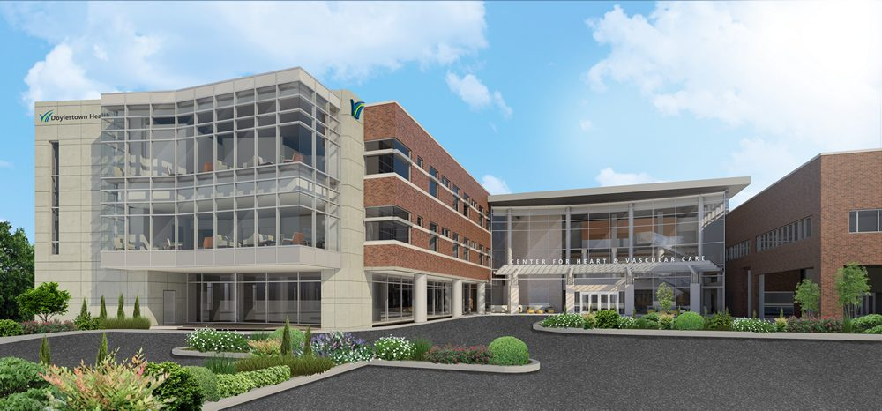
Project Background
Analysis I: Prefab Exterior
Doylestown Hospital
Heart Institute
Analysis II: Precast Footing
Analysis III: Modularization
Analysis IV: Sustainability
Jessica Serna
Construction Option
Advisor: Dr. Obonyo
Conclusions
Closing Remarks

Slide 2
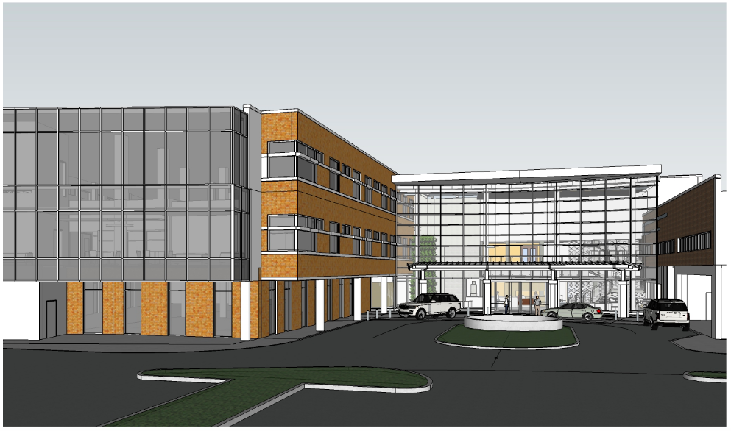
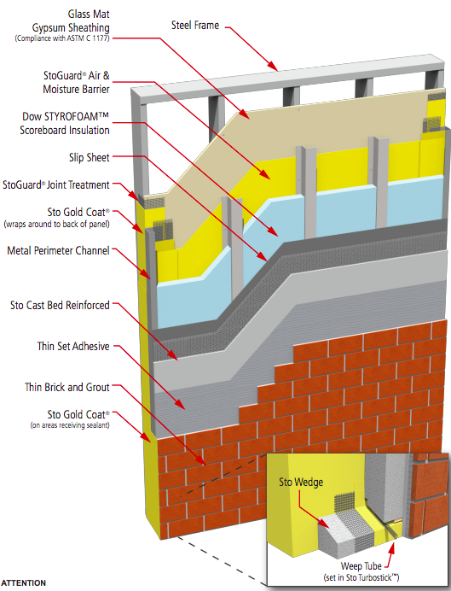
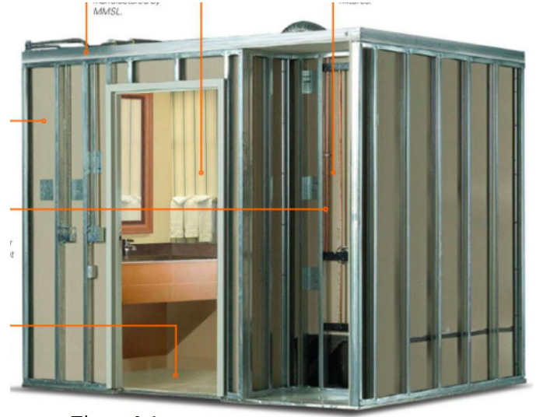
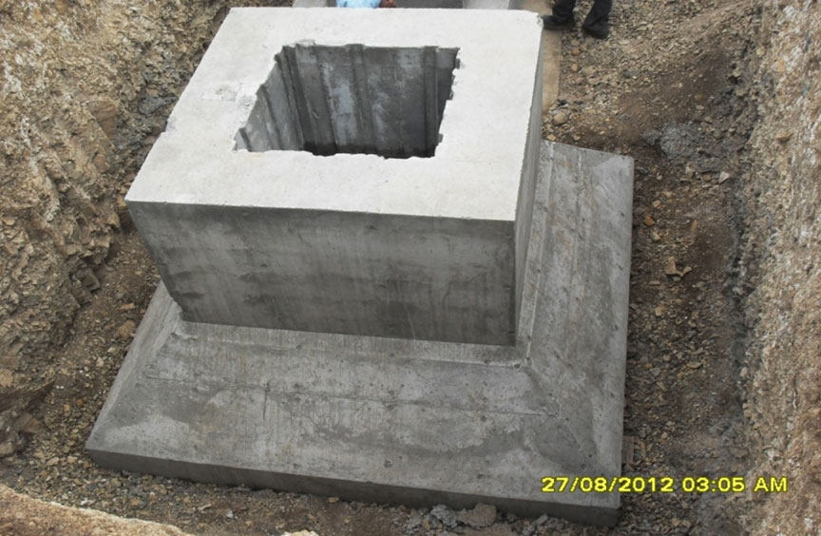
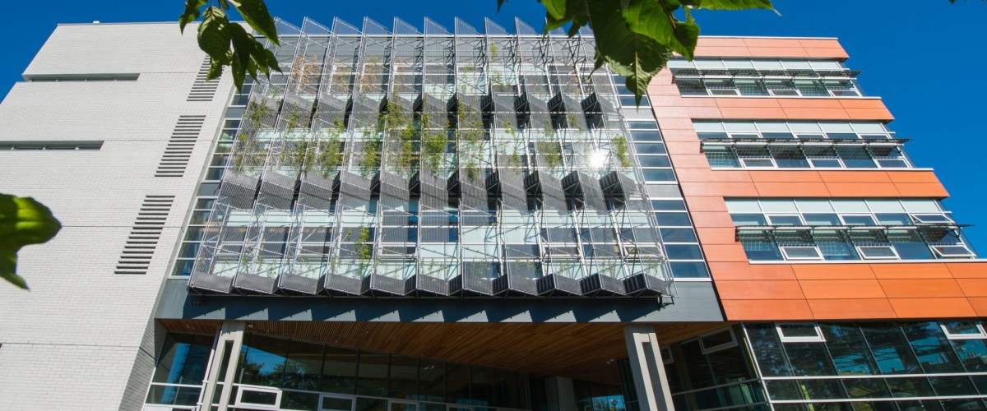
Project Background
PRESENTATION OVERVIEW
Analysis I: Prefab Exterior
Analysis II: Precast Footing
Analysis III: Modularization
Analysis IV: Sustainability
Conclusions
Closing Remarks
ANALYSIS I PREFAB EXTERIOR WALL
ANALYSIS II PRECAST FOOTINGS
ANALYSIS III MODULAR BATHROOM PODS
ANALYSIS IV SUSTAINABILITY

Slide 3
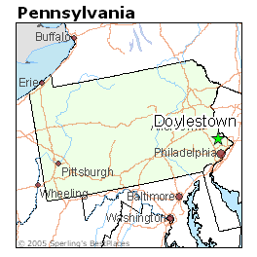
Doylestown Hospital Heart Institute
Project Background
PROJECT INFORMATION
Analysis I: Prefab Exterior
Project Name:
Location:
Size:
Cost:
Schedule:
Doylestown Hospital Phase D: Heart Institute
595 W State Street, Doylestown, PA
66,837 SF
$40M
March 2017 - November 2019
Analysis II: Precast Footing
Analysis III: Modularization
Analysis IV: Sustainability
March 2017
September 2017
February 2019
November 2019
Conclusions
DD
Project Breaks Ground
Substantial Completion
Final Completion
Closing Remarks
Notes:
Addition to an existing hospital, 4 levels
Joint Occupancy/active hospital
Encompasses existing

Slide 4
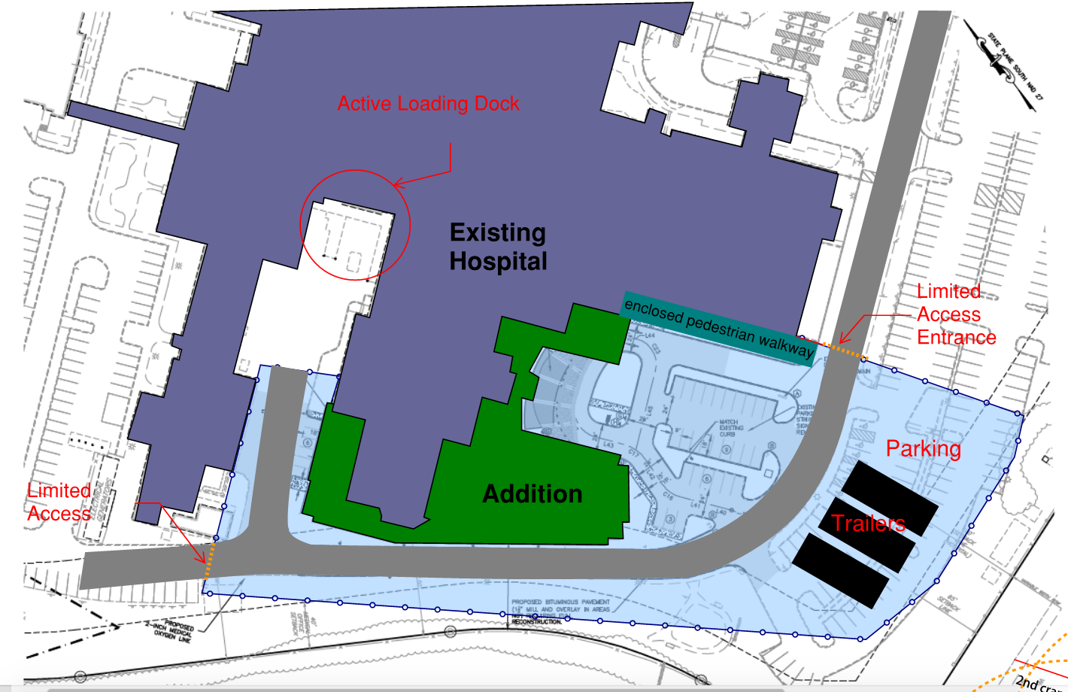
Doylestown Hospital Heart Institute
Project Background
PROJECT INFORMATION
SITE LOGISTICS
Analysis I: Prefab Exterior
Delivery Method:
Owner:
GC’s:
Design-Bid-Build
Doylestown Health
Joint Venture
Analysis II: Precast Footing
Analysis III: Modularization
Norwood Company – John S. McManus Inc
Analysis IV: Sustainability
Conclusions
Closing Remarks
Notes:
Addition to an existing hospital, 4 levels
Joint Occupancy/active hospital
Encompasses existing

Slide 5
Doylestown Hospital Heart Institute
Project Background
ANALYSIS I: PREFAB EXTERIOR WALL PANELS
Problem: Limited Laydown Area on Site Active Loading Dock
Schedule Delays Early On
Analysis I: Prefab Exterior
Analysis II: Precast Footing
Analysis III: Modularization
Goals: Reduce Site Congestion
Reduce Schedule Duration
Improve Quality
Analysis IV: Sustainability
Conclusions
Closing Remarks
Notes:
Addition to an existing hospital, 4 levels
Joint Occupancy/active hospital
Encompasses existing

Slide 6
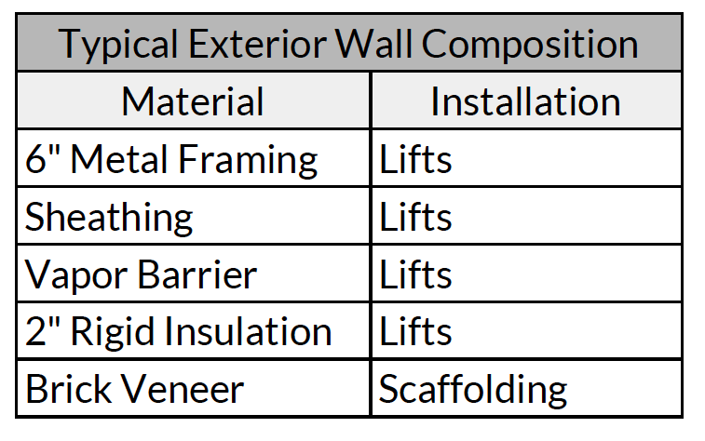
ANALYSIS I: PREFAB EXTERIOR WALL PANELS
Doylestown Hospital Heart Institute
Project Background
CURRENT SYSTEM
PROPOSED SYSTEM
Analysis I: Prefab Exterior
Panels Manufactured Off-site
High quality
Lightweight
Installed with Crane
Analysis II: Precast Footing
Analysis III: Modularization
Analysis IV: Sustainability
Conclusions
Closing Remarks
Notes:
Addition to an existing hospital, 4 levels
Joint Occupancy/active hospital
Encompasses existing

Slide 7
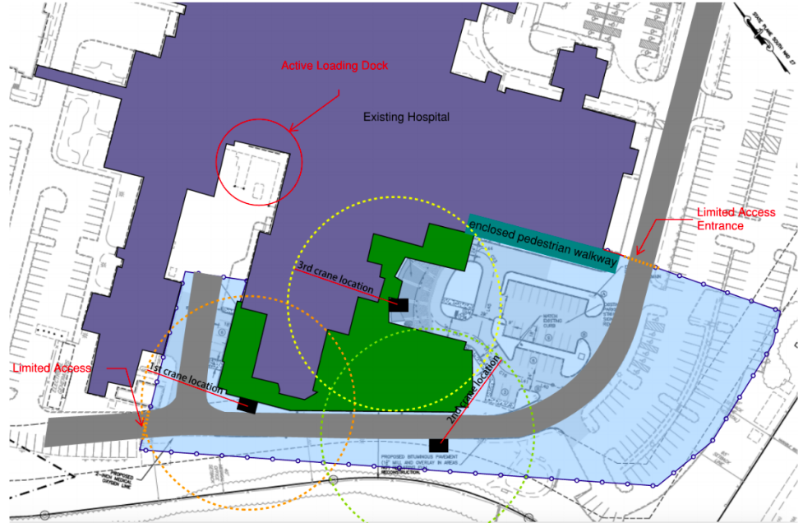
ANALYSIS I: PREFAB EXTERIOR WALL PANELS
Doylestown Hospital Heart Institute
Project Background
Analysis I: Prefab Exterior
100 Ton Crane
Begin on Northwest side
Counterclockwise
Analysis II: Precast Footing
Analysis III: Modularization
Analysis IV: Sustainability
Conclusions
Closing Remarks
Notes:
Addition to an existing hospital, 4 levels
Joint Occupancy/active hospital
Encompasses existing

Slide 8
ANALYSIS I: PREFAB EXTERIOR WALL PANELS
Doylestown Hospital Heart Institute
Project Background
CURRENT SCHEDULE− 64 DAYS
Analysis I: Prefab Exterior
20,307 SF of Prefab
Average Panel 198 SF
103 Panels in Total
Analysis II: Precast Footing
May 15, 2018
Aug 14, 2018
Analysis III: Modularization
PREFAB SCHEDULE − 23 DAYS
Analysis IV: Sustainability
41 Day
Schedule Reduction
May 15, 2018
June 15, 2018
Conclusions
Closing Remarks
Notes:
Addition to an existing hospital, 4 levels
Joint Occupancy/active hospital
Encompasses existing

Slide 9
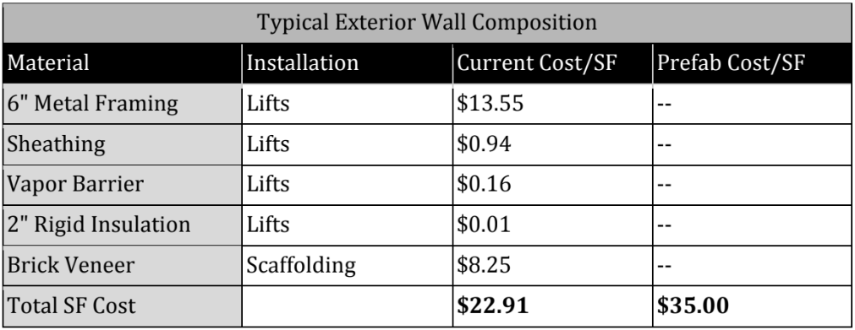
ANALYSIS I: PREFAB EXTERIOR WALL PANELS
Doylestown Hospital Heart Institute
Project Background
COST COMPARISON
PREFAB WALL
Analysis I: Prefab Exterior
Analysis II: Precast Footing
$12.09 PER SF
Analysis III: Modularization
+ $245,512 TOTAL PROJECT COST
Analysis IV: Sustainability
Conclusions
Closing Remarks
Notes:
Addition to an existing hospital, 4 levels
Joint Occupancy/active hospital
Encompasses existing

Slide 10
ANALYSIS I: PREFAB EXTERIOR WALL PANELS
Doylestown Hospital Heart Institute
Project Background
CONCLUSION/RECOMMENDATION
PREFAB WALL: RECOMMENDED
Analysis I: Prefab Exterior
Accelerates Schedule
Reduces Labor
Improves Quality
Less Site Laydown Required
Increases Project Cost
Analysis II: Precast Footing
Analysis III: Modularization
Analysis IV: Sustainability
Conclusions
Closing Remarks
Notes:
Addition to an existing hospital, 4 levels
Joint Occupancy/active hospital
Encompasses existing

Slide 11
Doylestown Hospital Heart Institute
Project Background
ANALYSIS II: PRECAST FOOTINGS
Problem: Behind Schedule Due to Delays with Underground Utilities
Analysis I: Prefab Exterior
Analysis II: Precast Footing
Analysis III: Modularization
Goals: Reduce Foundation Schedule Duration
Improve Quality
Analysis IV: Sustainability
Conclusions
Closing Remarks
Notes:
Addition to an existing hospital, 4 levels
Joint Occupancy/active hospital
Encompasses existing

Slide 12
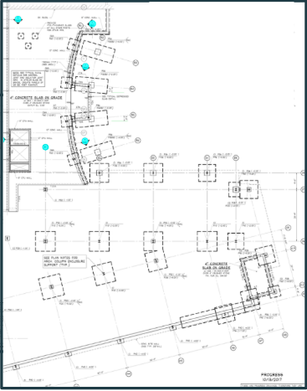
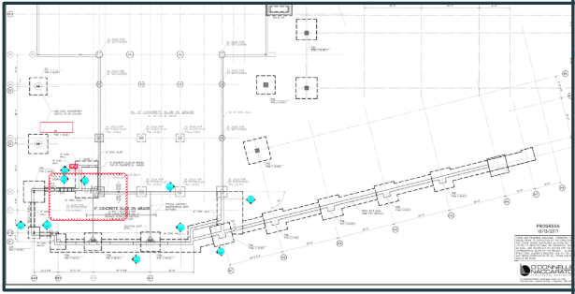
ANALYSIS II: PRECAST FOOTINGS
Doylestown Hospital Heart Institute
Project Background
CURRENT METHOD
First Floor
Analysis I: Prefab Exterior
Cast-in Place
Sloped Site - Footings on Ground Floor and First Floor
41 Footings
Size: 3x3 - 11x11
Analysis II: Precast Footing
Ground Floor
Analysis III: Modularization
Analysis IV: Sustainability
Conclusions
Closing Remarks
Notes:
Addition to an existing hospital, 4 levels
Joint Occupancy/active hospital
Encompasses existing

Slide 13
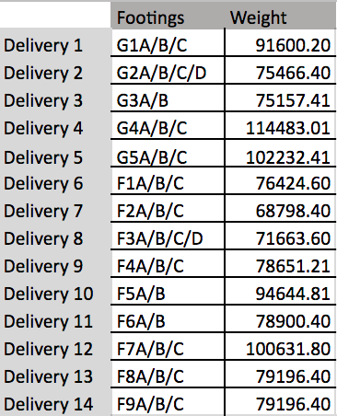
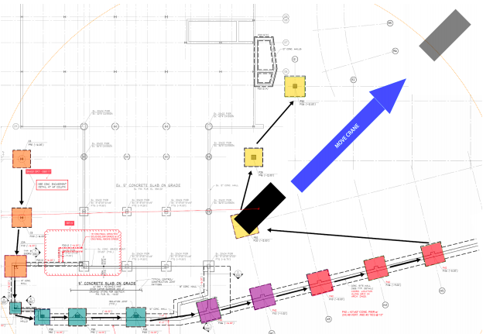
ANALYSIS II: PRECAST FOOTINGS
Doylestown Hospital Heart Institute
Project Background
LIMITATIONS
Analysis I: Prefab Exterior
Truck Width: 8’6”
Load: 80,000 lbs
25 Oversized Footings
Additional Fees
Analysis II: Precast Footing
Analysis III: Modularization
Analysis IV: Sustainability
Conclusions
Closing Remarks
Notes:
Addition to an existing hospital, 4 levels
Joint Occupancy/active hospital
Encompasses existing

Slide 14
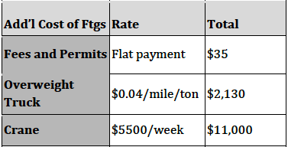
ANALYSIS II: PRECAST FOOTINGS
Doylestown Hospital Heart Institute
Project Background
SCHEDULE COMPARISON
COST COMPARISON
Analysis I: Prefab Exterior
Current Schedule
Ground Floor
10 Days
First Floor
5 Days
Interior
5 Days
Atrium
5 Days
Analysis II: Precast Footing
Analysis III: Modularization
Precast Schedule
Precast Footings
14 Days
11 Day Reduction
Analysis IV: Sustainability
Oversized Truck
Additional Equipment
Conclusions
Closing Remarks
Notes:
Addition to an existing hospital, 4 levels
Joint Occupancy/active hospital
Encompasses existing

Slide 15
ANALYSIS II: PRECAST FOOTINGS
Doylestown Hospital Heart Institute
Project Background
CONCLUSION/RECOMMENDATION
PRECAST FOOTINGS: NOT RECOMMENDED
Analysis I: Prefab Exterior
Accelerates Schedule – 11 Days
Reduces Material On Site
Increases Project Cost
Additional Site Equipment
Analysis II: Precast Footing
Analysis III: Modularization
Analysis IV: Sustainability
Conclusions
Closing Remarks
Notes:
Footings vary in size
Only 2 footings per truck delivery

Slide 16
Doylestown Hospital Heart Institute
Project Background
ANALYSIS III: MODULARIZATION
PATIENT BATHROOMS
Problem: Project Over Budget
Tight Schedule
Analysis I: Prefab Exterior
Analysis II: Precast Footing
Analysis III: Modularization
Goals: Reduce Schedule Duration
Reduce Cost
Improve Quality
Analysis IV: Sustainability
Conclusions
Closing Remarks
Notes:
Addition to an existing hospital, 4 levels
Joint Occupancy/active hospital
Encompasses existing

Slide 17
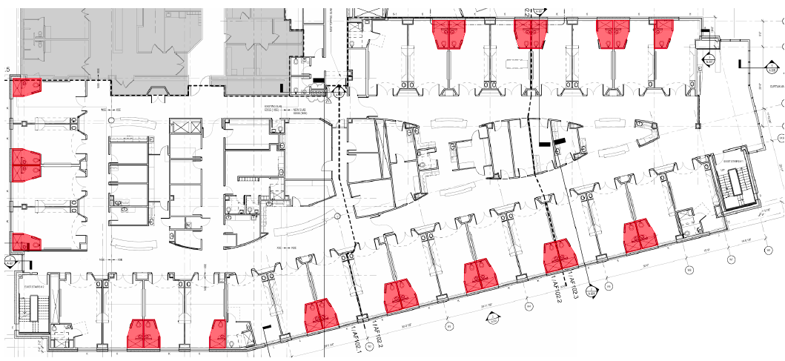
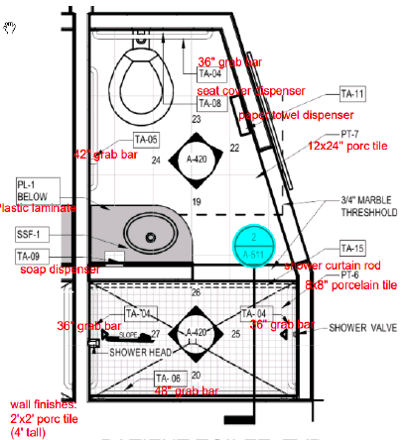
ANALYSIS III: MODULAR BATHROOM
Doylestown Hospital Heart Institute
Project Background
TYPICAL PATIENT BATHROOM
Analysis I: Prefab Exterior
Analysis II: Precast Footing
Analysis III: Modularization
Analysis IV: Sustainability
Conclusions
Closing Remarks
Notes:
Addition to an existing hospital, 4 levels
Joint Occupancy/active hospital
Encompasses existing

Slide 18
ANALYSIS III: MODULAR BATHROOM
Doylestown Hospital Heart Institute
Project Background
TYPICAL PATIENT BATHROOM
Analysis I: Prefab Exterior
Redundancy: Identical Second and Third Floors
48 Bathrooms
10’3” x 6’
Analysis II: Precast Footing
Analysis III: Modularization
Analysis IV: Sustainability
Conclusions
Closing Remarks
Notes:
Addition to an existing hospital, 4 levels
Joint Occupancy/active hospital
Encompasses existing

Slide 19
ANALYSIS III: MODULAR BATHROOM
Doylestown Hospital Heart Institute
Project Background
COST COMPARISON
SCHEDULE COMPARISON
Analysis I: Prefab Exterior
Transportation
6 pods per truck
+$505/delivery
Total Inc. $4032
Labor
Reduced Labor Hours
Total Dec. $26,880
Total Duration: 4 Days
Original Duration: 36 Days
Analysis II: Precast Footing
Analysis III: Modularization
Analysis IV: Sustainability
32 Day Reduction
Conclusions
Closing Remarks
Notes:
Addition to an existing hospital, 4 levels
Joint Occupancy/active hospital
Encompasses existing

Slide 20
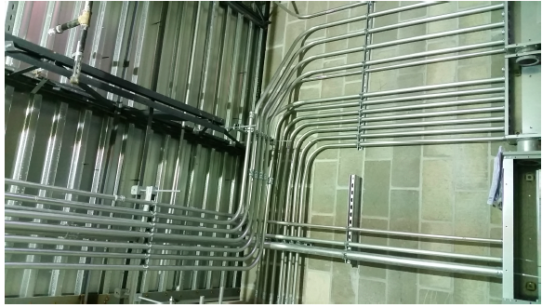
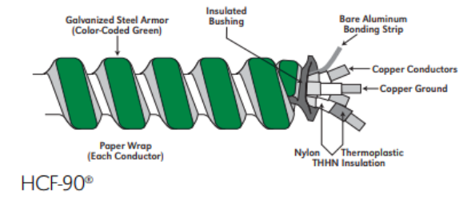
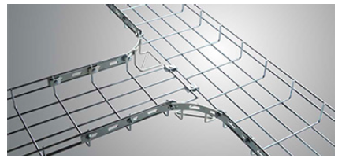
ANALYSIS III: MODULAR BATHROOM
Doylestown Hospital Heart Institute
Project Background
ELECTRICAL BREADTH
MC CABLE ON CABLE TRAYS
Analysis I: Prefab Exterior
Analysis II: Precast Footing
Analysis III: Modularization
Electrical Breadth
Analysis IV: Sustainability
Conclusions
Closing Remarks
Notes:
Addition to an existing hospital, 4 levels
Joint Occupancy/active hospital
Encompasses existing

Slide 21
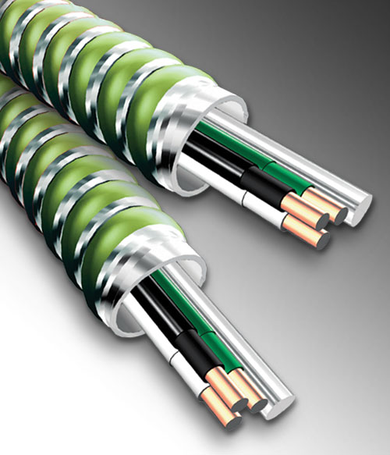
ANALYSIS III: MODULAR BATHROOM
Doylestown Hospital Heart Institute
Project Background
CURRENT METHOD
CABLE TRAYS
No limit on number of conductors
Trade size AWG 12/2 - 12/4
600 Maximum voltage rating
THHN conductor insulation
2 means of grounding
Meet UL and National Electrical Code (NEC) ratings
CABLE TRAYS
Support insulated electrical cables such as MC Cables that are used for power distribution, control, and communication
Analysis I: Prefab Exterior
¾” EMT Conduit
600V
Analysis II: Precast Footing
Analysis III: Modularization
Electrical Breadth
Analysis IV: Sustainability
Conclusions
Closing Remarks
Notes:
Addition to an existing hospital, 4 levels
Joint Occupancy/active hospital
Encompasses existing

Slide 22
ANALYSIS III: MODULAR BATHROOM
Doylestown Hospital Heart Institute
Project Background
CONCLUSION/RECOMMENDATION
MODULAR BATHROOM PODS
Analysis I: Prefab Exterior
Accelerates Schedule – 32 Days
Reduces Material On Site
Labor Cost Savings
Analysis II: Precast Footing
Analysis III: Modularization
Analysis IV: Sustainability
Conclusions
Closing Remarks
Notes:
Footings vary in size
Only 2 footings per truck delivery

Slide 23
Doylestown Hospital Heart Institute
Project Background
ANALYSIS IV: STUDENT LEADERSHIP IN SUSTAINABILITY
PACE INDUSTRY TOPIC
Problem: Lack Incorporation of Sustainable Design
Analysis I: Prefab Exterior
Analysis II: Precast Footing
Analysis III: Modularization
Goals: Reduce Foundation Schedule Duration
Improve Quality
Analysis IV: Sustainability
Conclusions
Closing Remarks
Notes:
Addition to an existing hospital, 4 levels
Joint Occupancy/active hospital
Encompasses existing

Slide 24
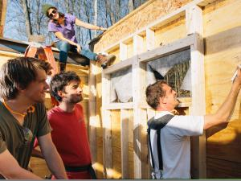
ANALYSIS IV: SUSTAINABILITY
Doylestown Hospital Heart Institute
Project Background
RESEARCH
Analysis I: Prefab Exterior
The University of British Columbia - Centre for Interactive Research on Sustainability
Analysis II: Precast Footing
Yestermorrow-UMass Semester in Sustainable Design/Build
Analysis III: Modularization
Surveys & Interviews
Analysis IV: Sustainability
Conclusions
Closing Remarks
Notes:
Addition to an existing hospital, 4 levels
Joint Occupancy/active hospital
Encompasses existing

Slide 25
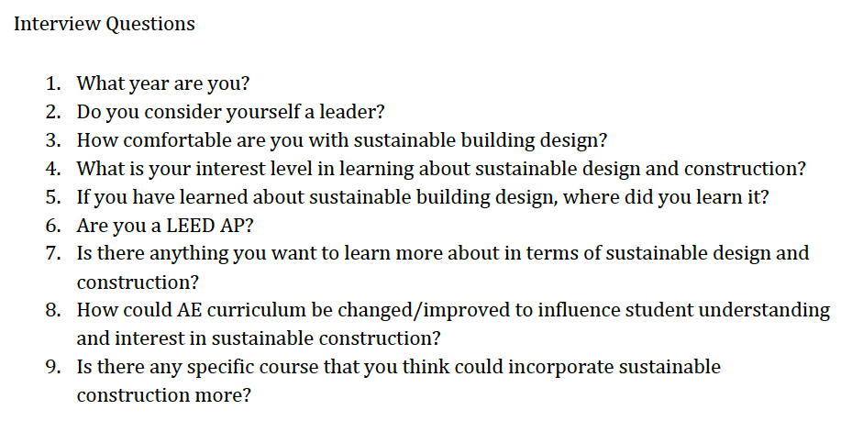
ANALYSIS IV: SUSTAINABILITY
Doylestown Hospital Heart Institute
Project Background
FINDINGS
Analysis I: Prefab Exterior
10 AE students/Alumni Interviewed – 3rd Year to 2 Years in the Industry
Analysis II: Precast Footing
100% Interested in Sustainable Building Design
1/10 Felt comfortable about incorporating sustainability in real world-applications
80% Learned about sustainable design in class
Sustainable Building Materials/Benefits
LEED Certification
Analysis III: Modularization
Analysis IV: Sustainability
Conclusions
Closing Remarks
Notes:
Addition to an existing hospital, 4 levels
Joint Occupancy/active hospital
Encompasses existing

Slide 26
ANALYSIS IV: SUSTAINABILITY
Doylestown Hospital Heart Institute
Project Background
CONCLUSION/RECOMMENDATION
Analysis I: Prefab Exterior
Guest Speakers
More Incorporation in 300 Level AE Classes
Include Sustainable Design in each Course
Study Abroad Opportunities
Analysis II: Precast Footing
Analysis III: Modularization
Analysis IV: Sustainability
Conclusions
Closing Remarks
Notes:
Addition to an existing hospital, 4 levels
Joint Occupancy/active hospital
Encompasses existing

Slide 27
CONCLUSIONS
Doylestown Hospital Heart Institute
Project Background
Analysis I: Prefab Exterior
Analysis II: Precast Footing
Analysis III: Modularization
Analysis IV: Sustainability
Conclusions
Closing Remarks
Notes:
Addition to an existing hospital, 4 levels
Joint Occupancy/active hospital
Encompasses existing

Slide 28
CLOSING REMARKS
Doylestown Hospital Heart Institute
Project Background
SPECIAL THANKS
Analysis I: Prefab Exterior
Analysis II: Precast Footing
Analysis III: Modularization
Analysis IV: Sustainability
Conclusions
Closing Remarks
Notes:
Addition to an existing hospital, 4 levels
Joint Occupancy/active hospital
Encompasses existing

Slide 29
CLOSING REMARKS
Doylestown Hospital Heart Institute
Project Background
QUESTIONS?
Analysis I: Prefab Exterior
Analysis II: Precast Footing
Analysis III: Modularization
Analysis IV: Sustainability
Conclusions
Closing Remarks
Notes:
Addition to an existing hospital, 4 levels
Joint Occupancy/active hospital
Encompasses existing

